Slide 1
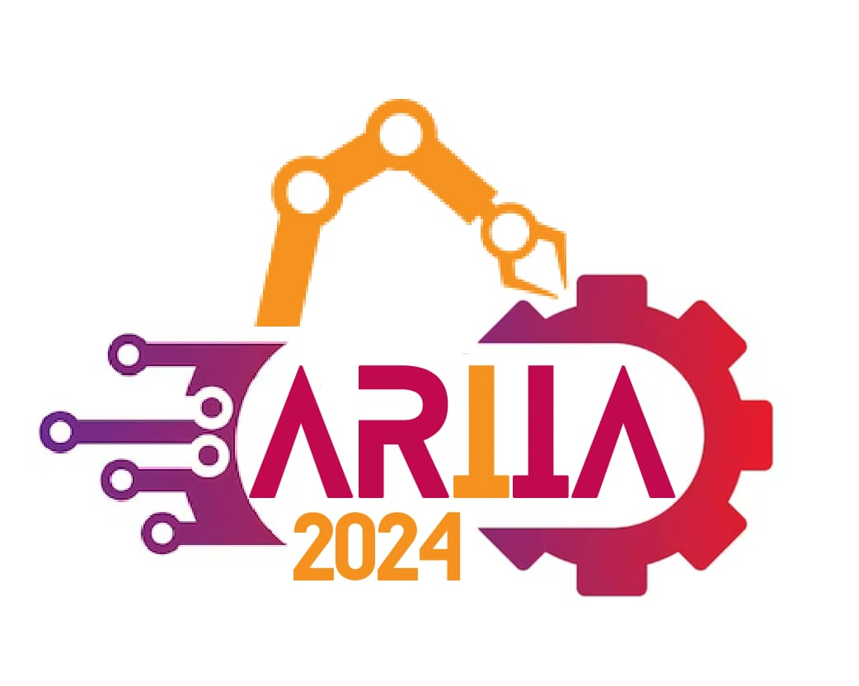
IEEE International Conference on Augmented Reality, Intelligent Systems and Industrial Automation
(ARIIA-2024)
AI in the Cloud - Tomorrow's Digital DNA: Transforming the Now
Presented by Hrushikesh Deshmukh
Date: Dec 29, 2024
20-21 December, 2024
Manipal Institute of Technology, Manipal

Slide 2
Welcome and Agenda
Agenda:
1. Introduction to AI and Cloud
2. The Synergy of AI and Cloud
3. Core Components of AI in the Cloud
4. Real-World Use Cases
5. Industry-Specific Applications
6. Emerging Trends in AI and Cloud
7. Challenges in AI-Cloud Integration
8. The Ethical Considerations
9. Future Outlook: AI in the Cloud
10. Case Studies
11. Key Takeaways and Call to Action

Slide 3
Introduction to AI and Cloud
Artificial Intelligence (AI):
- Simulating human intelligence through algorithms.
- Subfields include machine learning, natural language processing, and computer vision.
Cloud Computing:
- On-demand access to computing resources, storage, and services.
- Types: Public, Private, Hybrid, Multi-cloud.
Why Combine Them?
- AI’s demand for computational power aligns with cloud scalability.

Slide 4
The Synergy of AI and Cloud
AI and Cloud: A Perfect Match
- Elasticity for AI model training and deployment.
- Intelligent automation and decision-making.
Key Benefits:
- Real-time data processing at scale.
- Accelerated innovation cycles.
- Global accessibility of AI solutions.

Slide 5
Core Components of AI in the Cloud
Infrastructure:
- Compute power via GPUs and TPUs.
- Data storage optimized for AI workloads.
AI Services:
- Pre-trained models (e.g., vision, NLP).
- AI development platforms (e.g., TensorFlow, PyTorch).
Integration Tools:
- APIs for embedding AI features.
- Orchestration with Kubernetes.

Slide 6
Real-World Use Cases
Healthcare:
- AI for disease diagnosis and predictive analytics.
Finance:
- Fraud detection and enhanced customer service.
Retail:
- Personalized recommendations.
- Supply chain optimization.

Slide 7
Industry-Specific Applications
Manufacturing:
- Predictive maintenance with IoT and AI.
- Quality control using computer vision.
Education:
- AI-powered learning platforms.
- Personalized educational experiences.
Transportation:
- Autonomous vehicle systems.
- Real-time traffic management analytics.

Slide 8
Emerging Trends in AI and Cloud
Hybrid Cloud AI: Secure AI processing.
AI-Driven DevOps: Automated deployment and monitoring.
Edge AI: Real-time decisions at edge devices.
Green AI: Energy-efficient models and sustainable resources.

Slide 9
Challenges in AI-Cloud Integration
Data Privacy and Security:
- Compliance with GDPR, CCPA, etc.
- Secure storage of sensitive data.
Infrastructure Costs:
- Managing high cloud costs for AI operations.
Skill Gaps:
- Bridging gaps between cloud engineers and data scientists.

Slide 10
The Ethical Considerations
Bias in AI Models:
- Ensuring fairness and mitigating discriminatory outcomes.
Transparency:
- Explainable AI decisions.
Environmental Impact:
- Reducing the carbon footprint of AI training.

Slide 11
Future Outlook: AI in the Cloud
Next-Generation Trends:
- Quantum computing in cloud AI.
- Self-learning AI models.
- Multi-cloud strategies for optimization.
Vision for Tomorrow:
- AI and cloud driving innovation.
- Everyday life enhanced by ubiquitous AI.

Slide 12
Case Studies
Case Study 1: Global Retailer - Supply Chain Efficiency
- Problem: Siloed data and manual processes.
- Solution: AI-integrated real-time data streams.
- Outcome: 30% better demand forecasting, 20% inventory cost reduction.
- Tools: AWS SageMaker, Google BigQuery.
Case Study 2: Healthcare Startup - AI Diagnostics
- Problem: Lack of rural diagnostic tools.
- Solution: AI models analyzing X-rays, MRIs in the cloud.
- Outcome: 95% diagnostic accuracy.
- Tools: Azure Health Bot, TensorFlow.
Case Study 3: Financial Institution - Fraud Detection
- Problem: Rising fraudulent transactions.
- Solution: Real-time fraud detection with cloud AI.
- Outcome: 40% reduction in fraud incidents.
- Tools: Google Cloud AI, BigQuery ML.

Slide 13
Key Takeaways
AI and cloud democratize access to advanced tech.
Address challenges: security, cost, ethics.
Align organizational strategies to maximize synergy.

Slide 14
Call to Action
Integrate
Integrate AI in cloud strategies now.
Invest in
Invest in talent and tools for transformation.
Collaborate
Collaborate to overcome barriers and unlock innovation.

Slide 15
IEEE International Conference on Augmented Reality, Intelligent Systems and Industrial Automation
(ARIIA-2024)
Thank You
20-21 December, 2024
Manipal Institute of Technology, Manipal

