Slide 1

AI-Powered Multi-Cloud Security and Governance
“Redefining Trust and Resilience in a Hybrid World”
Keynote Speaker & Presenter: Hrushikesh Deshmukh
ICMR-2024 Conference

Slide 2
The Multi-Cloud Era: Opportunities and Risks
Multi-cloud adoption rate: 92% of enterprises.
Risks: Data silos, inconsistent policies, evolving cyber threats.
AI's role: Strategic necessity for managing risks and enhancing efficiency.

Slide 3
AI as a Game-Changer for Multi-Cloud Security
Threat Detection: Real-time analysis of multi-cloud data.
Behavioral Analytics: Detect unusual patterns and misconfigurations.
Incident Response: AI reduces MTTD and MTTR.
Example: Azure Sentinel, AWS GuardDuty.

Slide 4
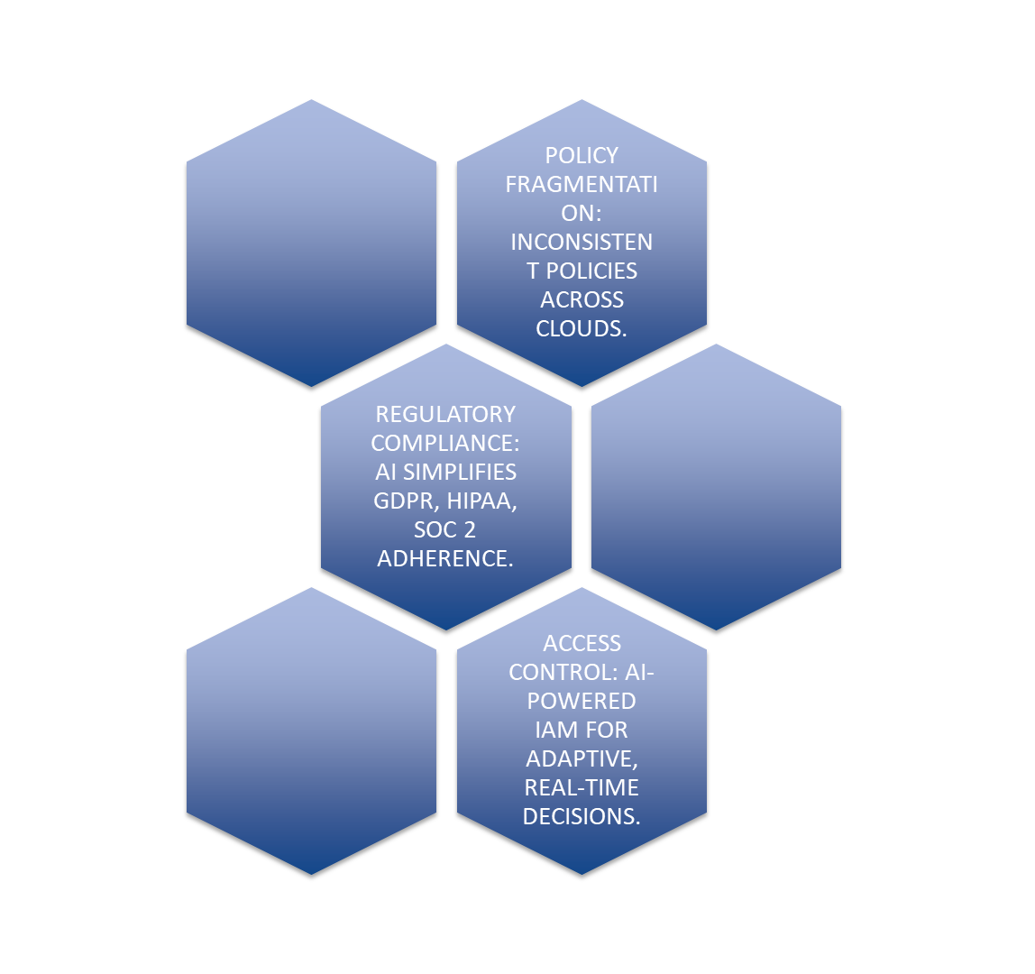


Slide 5
AI-Powered Governance Solutions
Unified Policy Enforcement: Consistent policies across environments.
Audit & Visibility: Real-time audit trails and governance gap detection.
Compliance Automation: Mapping regulations with AI frameworks.
Example: 35% faster compliance readiness across AWS and Azure.

Slide 6
Trust and Resilience in AI-Driven Multi-Cloud Security
Ethical AI Usage: Data transparency and explainable AI.
Augmentation vs. Replacement: AI supports human judgment.
Resilience: Combining AI defenses with robust failover strategies.

Slide 7
The Future of AI-Powered Multi-Cloud Security
Zero Trust Architecture: AI-driven continuous verification.
Predictive Governance: Forecasting compliance risks with AI.
Cloud-Agnostic Security: AI frameworks across AWS, Azure, and GCP.

Slide 8
Call to Action
Adopt AI with ethical intent.
Build secure, trustworthy multi-cloud systems.
Lead the way in AI-driven governance and security.

Slide 9

Thank You

